Slide 1


Research on Prediction of Dogecoin Cryptocurrency price
DSC680
Sharath Chandra Tummanapally
Aug 3, 2022

Slide 2
Over the past couple of years, dogecoin has set the trend for investors to place their trust and money in cryptocurrencies, and there is no doubt that this trend is here to stay. So, wouldn't it be fantastic if we could forecast the price of Dogecoin for tomorrow?
Business Problem

Slide 3
The first cryptocurrency, Bitcoin, was an astounding technical advancement that allowed anyone to exchange digital cash for negligible fees and without having to seek anyone's permission. But because Bitcoin was open source, anyone could replicate it, and at one point, everyone did, leading to the emergence of clones like Litecoin and Peercoin everywhere.
The humorous response to this tendency is Dogecoin. In the year 2013, software developers Billy Markus and Jackson Palmer came up with the idea for Dogecoin as a "joke," mocking the irrational speculation that was going on in the cryptocurrency market at the time. In particular, it is regarded as the first "dog coin" and the first "meme coin." Some people view it as a viable investment opportunity even though it is satirical.
Background/ History

Slide 4
Data Source/Dataset
The dataset I retrieved is from an online source Kaggle, where it provides the attributes of the daily price action for Doge coin particularly the Date, Open, High, Low, Close and Volume. We will get through the data in detailed as we dig deep into data and clean it for our analysis.
Source: https://www.kaggle.com/datasets/neelgajare/dogecoin-historical-price-data

Slide 5
Data Preprocessing
Firstly, I normalized the data using Scikit-Learn MinMaxScaler so that all the values are ranged from 0 to 1 and reshaped the data to 2D array.
Extracted 80% of closing prices from our dataset as our training set and the rest as testing set.
For preparation of training and test sets, I Created 60 days window of historical prices as feature data and the following 60-days window as label data, converted data format to numpy array and reshaped to 3D array.

Slide 6
Building and Evaluating Model
Define a Sequential model using open-source machine learning library, Tensorflow.
Added two LSTM layers with 100 network units and densely connected neural network layer with 25 network units.
At last, added a densely connected layer that gives the output of 1 network unit.
Trained and Evaluated model by calculating RMSE metric.
Finally, visualized the predicted prices.

Slide 7
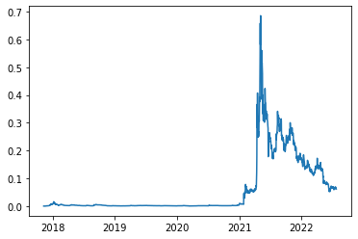
Visualizations
Dogecoin Historical Price Map

Slide 8
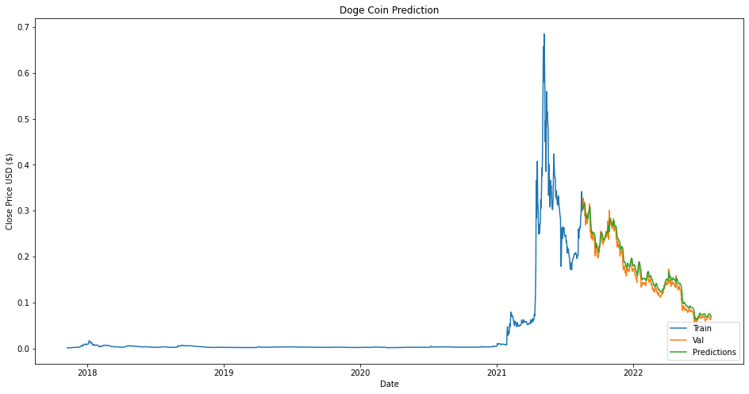
Visualizations
Dogecoin Prediction Price Map

Slide 9
Conclusion
Our findings show that the RMSE is only about 0.00873. The model appears to be working fine. We found that LSTM is a useful tool for predicting cryptocurrency prices. It is important to note, however, that forecasted cryptocurrency prices should not be used as a sole guide to make an investment decision without further analysis. This is because the prediction is based on past price movement, which is not always the only factor influencing future price movement.

Slide 10
Questions/ Answers
What are the limitations of this research?
The fundamental drawback of utilizing any machine learning system to forecast cryptocurrency prices is that we can only run a backtest on previous data, and under various unpredictable circumstances, price movement may not necessarily follow the historical trend.
What are the Challenges faced in this research?
To setup the tensorflow environment on my computer was a bit challenging. There were multiple versions of tensorflow and I constantly faced the dead kernel issue in the Jupyter notebook. I had to figure out the working tensorflow version for this model.
How can we implement this in future businesses?
This model could work for various stocks and cryptocurrencies to predict the price however, it is important to note, that forecasted prices should not be used as a sole guide to make an investment decision without further analysis.

Slide 11
Ethical Assessment
Cryptocurrencies are not subject to centralized control. One of the most important ethical issues for governments and academics about cryptocurrencies is the absence of regulation and a central authority that is answerable. It's a key factor in why numerous nations have outlawed cryptocurrencies. Customers have access to a payment mechanism using cryptocurrencies that can get through institutionalized regulatory procedures. As a result, the payment system has created a setting that is ideal for unlawful behavior. It seems that the primary means of payment for illicit behavior is cryptocurrency.

Slide 12
Thank You!!

